Slide 1
Java Introduction Review

Slide 2
Follow the Steps
Install JDK with JRE: https://www.oracle.com/java/technologies/javase-downloads.html
Install the Java Integrated development Environment (IDE): “Intellij IDEA” https://www.jetbrains.com/idea/download/#section=windows
Take help for installation from the following link: https://www.youtube.com/watch?v=EMLTOMdIz4w

Slide 3
What is Java?
JAVA was developed by Sun Microsystems Inc, later acquired by Oracle Corporation.
It was developed by James Gosling, Mike Sheridan and Patrick Naughton.
More than 3 billion devices run Java.
It is used for:
Mobile applications (specially Android apps)
Desktop applications
Web applications
Web servers and application servers
Games
Database connection
And much, much more!

Slide 4
First Java Program
In Java, every application begins with a class name, and that class must match the filename.
Let's create our first Java file, called CSEJU.java, which can be done in any text editor (like Notepad).
The file should contain a "Welcome to CSE JU." message, which is written with the following code:
public class CSEJU{ public static void main(String[] args) { System.out.println("Welcome to CSE JU."); } }
Save the code in Notepad as “CSEJU.java".

Slide 5
First Java Program Cont..
Open Command Prompt (cmd.exe), navigate to the directory where you saved your file, and type
"javac CSEJU.java "
This will compile your code. If there are no errors in the code, the command prompt will take you to the next line. Now, type "java CSEJU" to run the file:
The output should be:
Congratulations!!! you have written and executed your first Java program
C:\Users\Your Name>javac CSEJU.java
C:\Users\Your Name>java CSEJU
Welcome to CSE JU.

Slide 6
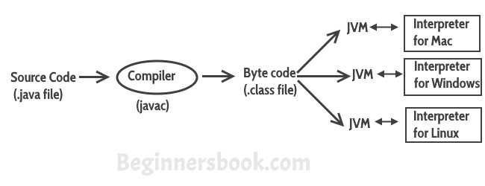
Java Terminologies Summary
Figure: Different JVM for different OS but byte code is same.

Slide 7
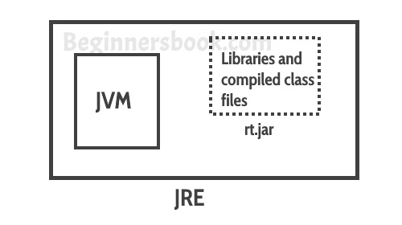
JRE vs JVM vs JDK
JRE is the environment within which the java virtual machine runs. JRE contains Java virtual Machine(JVM), class libraries, and other files, excluding development tools such as compiler and debugger. Which means you can run the code in JRE but you can’t develop and compile the code in JRE.
JVM: As we discussed above, JVM runs the program by using class, libraries and files provided by JRE.

Slide 8
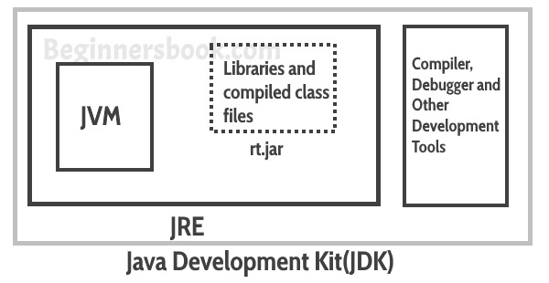
JRE vs JVM vs JDK
JDK: is a superset of JRE, it contains everything that JRE has along with development tools such as compiler, debugger etc.

Slide 9
Anatomy of First Program
public class CSEJU{ public static void main(String[] args) { System.out.println("Welcome to CSE JU."); } }

Slide 10
Anatomy of First Program cont…
public class CSEJU{
This is the first line of our java program. Every java application must have at least one class definition that consists of class keyword followed by class name.
When I say keyword, it means that it should not be changed, we should use it as it is. However the class name can be anything.
We will discuss the public access modifier later, all you need to know now that
a java file can have any number of classes
but it can have only one public class
and the file name should be same as public class name.

Slide 11
Anatomy of First Program cont…
public static void main(String[] args) {
This is our next line in the program, lets break it down to understand it:
public: This makes the main method public that means that we can call the method from outside the class.
static: We do not need to create object for static methods to run. They can run itself.
void: It does not return anything.
main: It is the method name. This is the entry point method from which the JVM can run your program.
(String[] args): Used for command line arguments that are passed as strings. We will cover it later.

Slide 12
Anatomy of First Program cont…
This method prints the contents inside the double quotes into the console and inserts a newline after.
System.out.println("Welcome to CSE JU.");

Slide 13
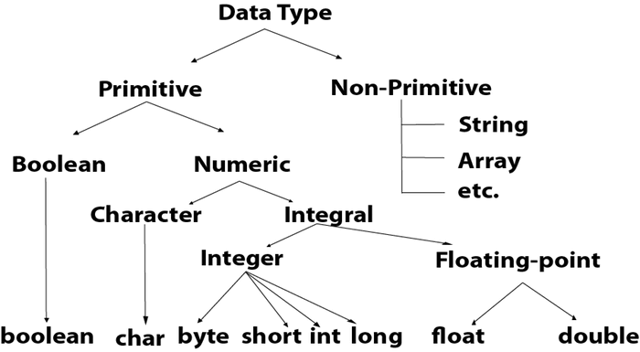
Java Data Types

Slide 14
Java Command Line Arguments
The java command-line argument is an argument i.e. passed at the time of running the java program.
The arguments passed from the console can be received in the java program and it can be used as an input.
OUTPUT:
Taking Command Line Arguments!!"
The argument is: Welcome
The argument is: to
The argument is: Online
The argument is: Class
public class CommandLineExample
{
public static void main(String args[])
{
System.out.println(“Taking Command Line Arguments!!");
for (int index=0; index<args.length; index++)
{
System.out.println(“The argument is: ” + args[index]);
}
}
Compile→ javac CommandLineExample.java
Interpret→ java CommandLineExample Welcome to Online Class

Slide 15
Java Basics
Java Type Casting……
Widening Casting
Narrowing Casting
Java Operators:
Arithmetic operators
Assignment operators
Comparison operators
Logical operators
Bitwise operators
Java Control Statements and Loops

Slide 16
Reading Materials
Java The Complete Reference
Author : Herbert Schildt
Chapter 1-5 of your text book
Web Source:
http://docs.oracle.com/javase/tutorial/
http://www.tutorialspoint.com/java/
http://www.javatpoint.com/java-tutorial/

